Slide 1




Data-Limited Methods Toolkit
Evaluating management strategies for data-limited fish species
Advanced operating model specification
Lecture 4a, Nov 22nd 2017
Tom Carruthers & Adrian Hordyk .

Slide 2
Agenda
Specifying historical effort trends
Time-varying selectivity
Preserving correlation among parameters
Conditioning OM by Stochastic SRA
Conditioning OM by Stock Synthesis

Slide 3
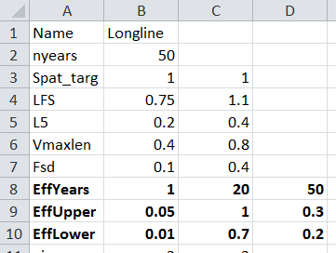
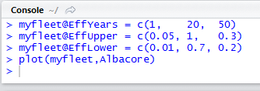
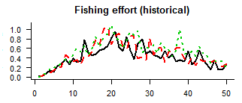
Specifying historical effort trends
The standard way to specify historical effort trends in a DLMtool Fleet object is to use vectors that represent the upper and lower bounds:

Slide 4
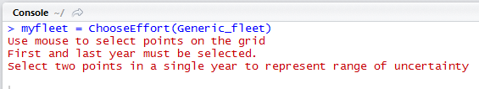
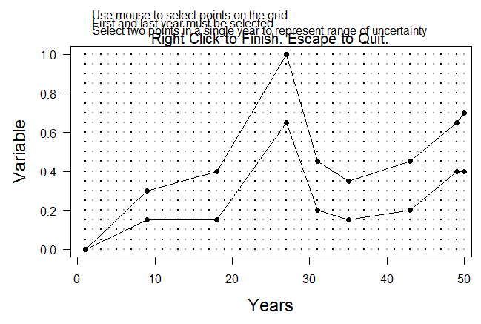
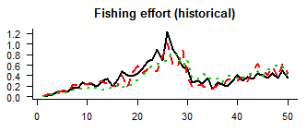
Specifying historical effort trends: drawing
An alternative way is to use the function ChooseEffort():

Slide 5
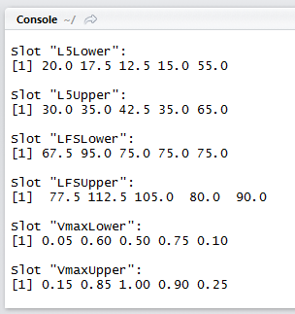
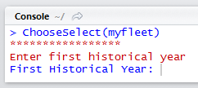
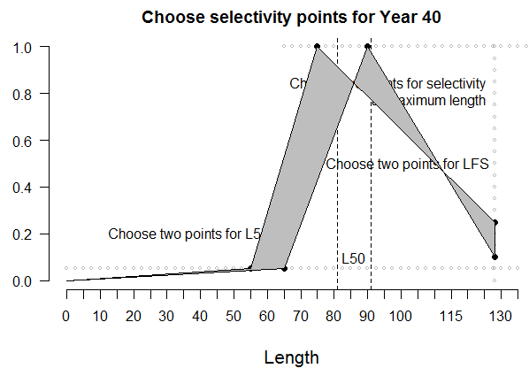
Time-varying selectivity
This can be done either in the csv or in the R session ie:

Slide 6
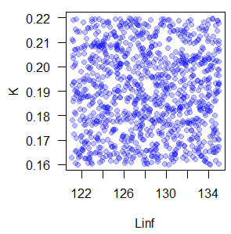
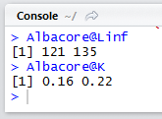
Preserving correlation among parameters
The default system of generating variability in parameters is to sampled them from uniform random variables with upper and lower bounds according to the slots in the corresponding object. E.g:

Slide 7
Introducing the @cpars slot:
All of the parameters, time series of fishing effort, stock depletion etc. can be specified by the user by using the @cpars slot.
This contains a set of random draws according to your own distributions including correlation if necessary.
When runMSE() is run, it ignores the uniform ranges and uses the samples in @cpars instead.
An example is the ForceCor() function of DLMtool that forces correlation among certain life-history parameters M, K, Linf, Length at 50% maturity.

Slide 8

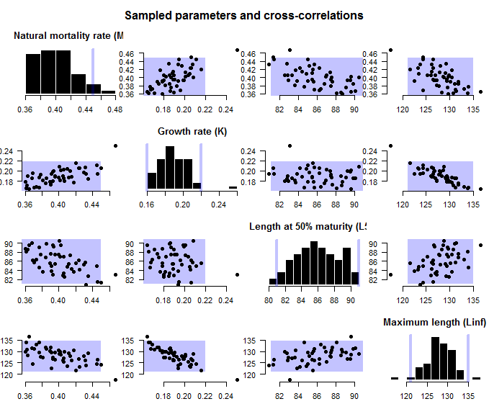
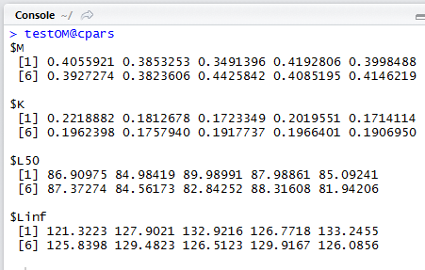

Slide 9
Conditioning OMs using Stochastic SRA
Walters et al. 2006 designed an MCMC algorithm for reconstructing stock trends using annual catches and catch composition data. This is recreated here in a function
StochasticSRA(testOM, CAA, Chist)
This function is applied to an operating model, a matrix of catch at age data CAA (years x ages), and a vector of annual historical catch data Chist.
The function is designed to map out a wide range of possible historical stock trends and exploitation scenarios and can be applied to very patchy (even just the last year) of age composition data.

Slide 10

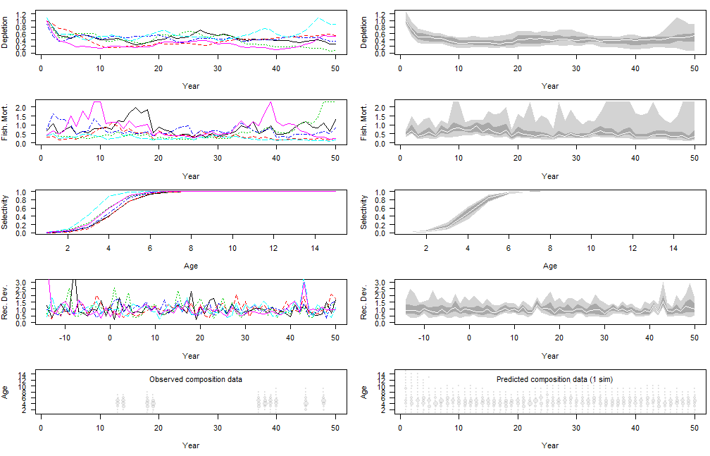
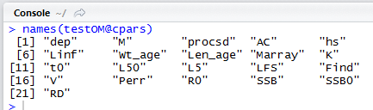

Slide 11
Conditioning OMs using Stock Synthesis
A DLMtool functions SS2DLM() and iSCAM2DLM() do something very similar to StochasticSRA() except they borrows the estimates from a fitted statistical catch at age assessment.
Both SS2DLM() and iSCAM2DLM() require the input and output files of an fitted assessment in a directory e.g.
myOM = SS2DLM(SSdir = “C:/SS3run/”)
So far SS2DLM has been tested on three fitted SS runs including Gulf of Mexico Red Snapper and Indian Ocean yellowfin tuna.
It is a work in progress and thus far only take MLE (best estimates) from the SS3 assessment.

Slide 12
Handy commands
ChooseEffort(Fleet object)
ChooseSelect(Fleet, Stock)
ForceCor(OM object)
StochasticSRA(OM, CAA, Chist)
SS2DLM(SSdir)
iSCAM2DLM(iSCAMdir)
ChooseEffort(Generic_Fleet)
ChooseSelect(Albacore, longline)
ForceCor(testOM)
StochasticSRA(testOM, CAA, Chist)
SS2DLM(“C:/Ssrun”)
iSCAM2DLM(“C:/iSCAMrun”)

